Slide 1
The New Goliaths
James Bessen
Technology & Policy Research Initiative, Boston University

Slide 2
What does new technology do?
Raises productivity
  E.g., electric vehicles
Alters select industries
  E.g., automobile, auto repair, gasoline
Does NOT typically change economic institutions

Slide 3
Technology is transforming the economy

Slide 4
2nd Industrial Revolution
Economies of scale
  Steel, oil, sugar,…
Changed
  Firm organization
    Market ➔ managerial hierarchies
  Labor markets / industrial unions
  Innovation: R&D
  Competition ➔ monopolies, cartels
  Regulation
    Progressive movement

Slide 5
Today…
1. Organization
  Internal and external platforms
2. Competition
  Declining “creative destruction”
  Rising industry concentration
3. Innovation: Slow tech diffusion
  Productivity gap
  Productivity slowdown
4. Labor:
“skills gap”
wage inequality
5. Ineffectual regulation

Slide 6
Information technology changes how firms use information

Slide 7
Information technology changes how firms use information
➔ Changes the Economy

Slide 8
NOT about Automation
Automation creates jobs as well as replaces workers
Automation is NOT transforming the economy
Automation imposes transitions
  New skills
  New jobs
  New occupations

Slide 9
1. Organization

Slide 11

Barcode scanner
Accessible
  Independent >> National chains
  Productivity gains
    Revenue / worker: + 5%
    Grocery prices: -1.4%
Small competitive advantage

Slide 12
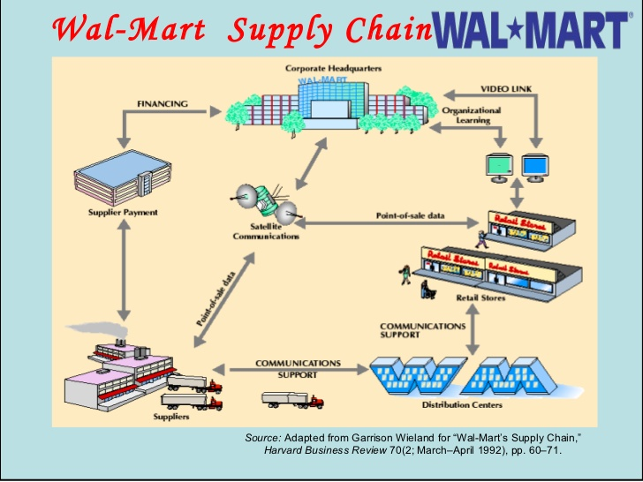
Walmart
Integrated system
  Suppliers / stores / distribution centers / headquarters

Slide 13
2nd Industrial Revolution
Economies of scale
Large centralized enterprises
Chain store (A&P)
  Standardized store selection
  Centralized buying
  Centralized warehouses

Slide 14
Chain store model
Suppliers
Efficiency thru standardization, centralization
Headquarters
Stores

Slide 15
Walmart model
Suppliers
Software
+
Organization
Headquarters
Stores

Slide 16
Walmart advantage
Many more items / store
  Greater selection, more attractive to consumers
Responsive to changes in demand & local demand
  Stores replenished more frequently
Reduced warehousing ➔ lower cost ➔ lower prices
Efficiency + heterogeneity
Market share: 3%, 1982 ➔ 52%, 2012; largest global retailer

Slide 17
What does Information Technology Do?
Standard
  Software: fixed cost, cheap to reproduce
  Low cost computers

Slide 18
What does Information Technology Do?
Standard
  Software: fixed cost, cheap to reproduce
  Low cost computers
Modularity reduces cost of complexity
  Store variety
  Product features
  Targeting / customization

Slide 19
Big SW ➔ Big firm dominance
Retail logistics & inventory, better selection & response
  Walmart, Amazon
Manufacturing SW, more features
  Aircraft $25-30b to design
  Autos $5-6 to design, 100 m. lines of code, > 100 computers
Targeted advertising, finer targeting
  Google, Facebook
Targeted credit offers, finer risk targeting
  Top 4 banks: 57% credit cards issued
  Chase, Capital One, Citibank

Slide 20
Competing on complexity
NOT just Big Tech
  Retail, wholesale
  Banking, insurance
  Tech
  Pharmacy benefit managers
  Waste management co.s…
Much of the economy
  45% of industries
  71% of revenue

Slide 22
Large firms dominate own-software
Firm size, excluding computer and computer service industries

Slide 23
Platforms
Software
+ Hardware
+ Organization
+ Data

Slide 24
Platforms
Software
+ Hardware
+ Organization
+ Data
Not just multi-sided open platforms…

Slide 25
Platforms
 | One sided | Multisided
Closed / internal | AWS <2006 | Walmart
Open / public | AWS >2006 | Amazon Marketplace

Slide 26
2. competition

Slide 27
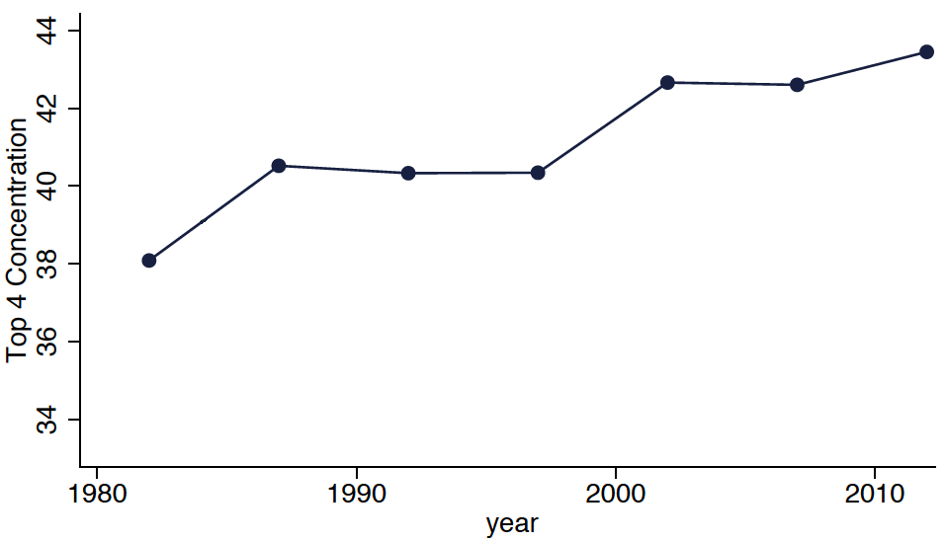
Rising Industry Concentration
Manufacturing
Source: Autor et al. 2017

Slide 28
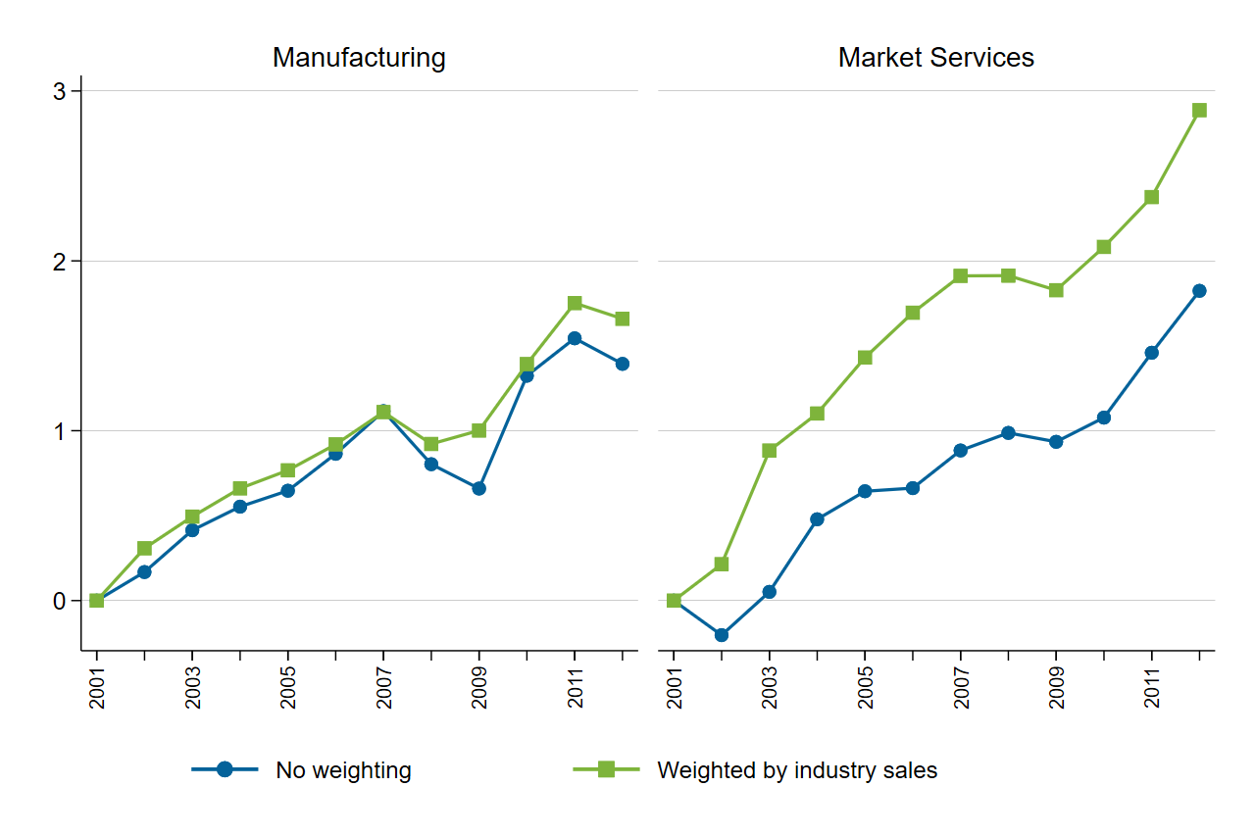
European countries: top 10% firm share output
Source: OECD 2019

Slide 29
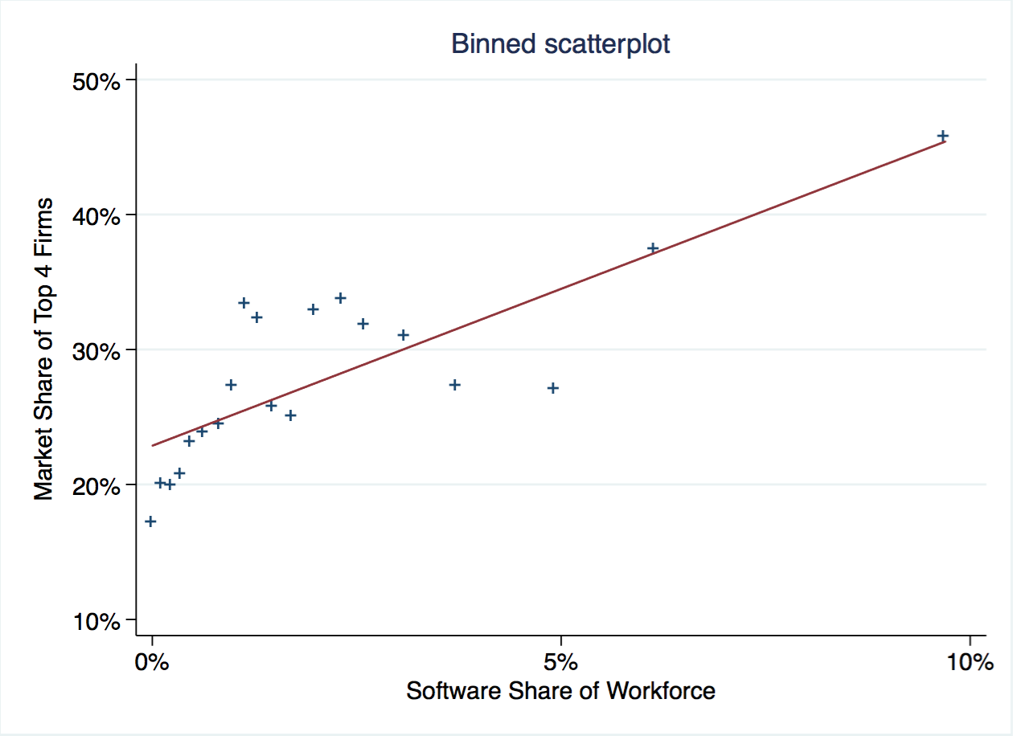
Technology?

Slide 30
Technology?
Causal

Slide 31
Rising Industry Concentration
Manufacturing
Proprietary IT
Source: Autor et al. 2017

Slide 32
Doesn’t new tech disrupt?

Slide 33
Doesn’t new tech disrupt?
NOT so much anymore…

Slide 34
Proprietary
Systems for own use; NOT general purpose technology
    Self-developed or contracted
    Complementary skilled workers, managers
    Organizational investments = “platforms”
Slow to “diffuse”:
    Not licensed or sold
    Hard to imitate

Slide 36
Select Platform firms
Competitive advantage
Grow market share
  Rivals grow more slowly
  ➔ rising concentration
More persistent
  Less disruption
  Less leapfrogging

Slide 37
3. innovation

Slide 38
Innovation process
Creating new ideas / techniques / knowledge
“Diffusion”
  Licensing
  Growth of productive firms
  ➔ Schumpeter

Slide 39
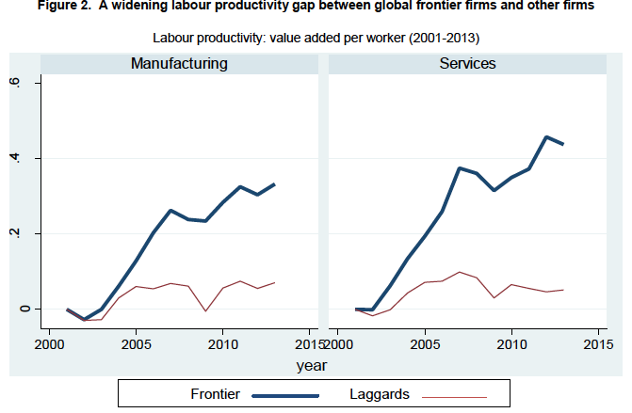
Productivity gap
Source: OECD 2016

Slide 40
Productivity gap

Slide 41
Gap = slower “diffusion”
Typical diffusion
  Licensing
  Invent around
  Alternative technology
  ➔ automatic transmission spread in 10 years
Now
  Limited access to smaller firms

Slide 42
Why slower?
No licensing when tech is used to differentiate
Platform complexity
  Software, hardware, data, personnel
  But firms can choose to “unbundle”…
Slower growth of productive firms
  Less disruption
  Slower reallocation
Declining employee mobility

Slide 43
No shortage of new ideas 1

Slide 44
No shortage of new ideas 2

Slide 45
Productive firms grow faster

Slide 46
Slower after 2000

Slide 47
Competing on complexity
Fintech firms have difficulty accessing consumers’ data
  Slower growth
Innovative retailers can’t handle large selection
Google Sheets limited success vs. Microsoft Excel
  Despite some better features
  Excel: 3,000 features; Office: 12,000

Slide 48
Slower after 2000
Decker et al. (2020):
Explains much of productivity slowdown

Slide 49
4. labor

Slide 50
Limited access
Select firms ➔ higher returns to skill
  Pay more

Slide 51
Superstar firms pay more

Slide 52
Limited access
Select firms ➔ higher returns to skill
  Pay more
  Greater wage inequality
    Most growth in inequality is between firms
Harder to gain experience
  “skills gap”
Talent war
  Startups pay premium to compete with Superstars

Slide 53
5. regulation

Slide 54
Dieselgate
Automobile
  100 million lines of code
“Clean Diesel”
  Start with low emissions
  Detect when not in emissions test (10 factors)
  Boost power & emissions 20x
Volkswagen
  11 million recalled
  $33 billion, fines, buybacks
  Jailtime
Volvo, Renault, Jeep, Hyundai, Citroën, Nissan, Mercedes-Benz, Porsche, Audi, and Fiat

Slide 55
Software evades regulators
Regulation more dependent on information
  Mandated disclosures
  Mechanism design
Complex SW ➔ opportunities to deceive
  Volkswagen diesel emissions
  Boeing 737 MAX
  Subprime mortgage loans

Slide 56
Next?

Slide 57
Today…
1. Organization
  Internal and external platforms
2. Competition
  Declining “creative destruction”
  Rising industry concentration
3. Innovation: Slow tech diffusion
  Productivity gap
  Productivity slowdown
4. Labor:
“skills gap,”
wage inequality
5. Ineffectual regulation

Slide 58
Unbundling
Amazon: superior IT infrastructure platform
2006➔ opens as AWS
  “Cloud” industry
    Small firms access most advanced capabilities
    Productivity growth
  Amazon makes $$$
Competition?
  Huge increase
  BUT also opportunity for abuse

Slide 59
Government?
Access code & data to enable regulation
Encourage unbundling
  Employee mobility
    Trade secrecy, patents, employee non-compete agreements
  Consent decrees / industry regulation
Example: fintech access to bank customer data
  EU
  Not US
  m

Slide 60
Government?
Access code & data to enable regulation
Encourage unbundling
  Employee mobility
    Trade secrecy, patents, employee non-compete agreements
  Consent decrees / industry regulation
To settle antitrust issues
  Compulsory patent licensing
  + Compulsory sharing of code, data, platforms
Training ➔ lifelong learning, experience

Slide 61
EU Digital Policies
Database Right, 1996
General Data Protection Regulation
    Personal information
Digital Services Act / Digital Markets Act
    Regulate social media and the largest online open platforms
AI Act [proposed]

Slide 62
EU Digital Policies
Database Right, 1996
General Data Protection Regulation
    Personal information
Digital Services Act / Digital Markets Act
    Regulate social media and the largest online open platforms
AI Act [proposed]
California
US proposed

Slide 63
Missing the target?
Big Tech isn’t the problem
  3-4% of US gross output
  SW intensive industries ~71% of gross output
Nor is it only US firms
Open Platforms are part of the solution
  Open platforms DO require antitrust oversight
  Open platforms CAN encourage massively greater competition

Slide 64
Conclusion: A New New Economy
In many industries, SW changing nature of competition
Competing on complexity:
  Industry concentration
  Less disruption
  Less diffusion
  Slower reallocation, productivity growth
  Greater income inequality
  Less effective regulation

Slide 65
Conclusion: A New New Economy
In many industries, SW changing nature of competition
Competing on complexity:
  Industry concentration
  Less disruption
  Less diffusion
  Slower reallocation, productivity growth
  Greater income inequality
  Less effective regulation
New Technological-Economic Paradigm

